Slide 1
Web Services

Slide 2
What is a Web Service?
Piece of software available over Internet
Uses standardized (i.e., XML) messaging system
More general definition: collection of protocols and standards used for exchanging data between applications or systems

Slide 3
Web Services Architecture
Technologies capable of
  Exchanging messages
  Describing Web services
  Publishing and discovering Web service descriptions

Slide 4
An Example: EMBL
EMBL nucleotide sequence database
http://www.ebi.ac.uk/cgi-bin/dbfetch
  X12399

Slide 5
Another Example: NOAA
Oceanographic data
Water level, currents data, etc.
http://opendap.co-ops.nos.noaa.gov/axis/

Slide 6
A service example
Previous two examples provide data
Web services can also perform analysis
Example: sequence similarity using ClustalW:
  http://www.ebi.ac.uk/clustalw/

Slide 7
Observations
Web services useful for both retrieval and analysis
  Leverage existing programs/data
  “Service-oriented science”
What if I want to analyze 100s of objects?

Slide 8
Service-Oriented Science
Idea: need standards and interfaces to encapsule information tools as services
No knowledge of inner workings required
Service oriented architecture: systems as networks of loosely-coupled, communicating services
Service oriented science: scientific research enabled by networks of interoperating services

Slide 9
Advantages for Scientists
Data on the web, not in the lab
Automate time-consuming activities
Infrastructure issues
  Share compute resources
Automation
  Enables programs to process large volumes of data quickly

Slide 10
Creating and Sharing Services
Describe operations service supports
Define protocol to invoke services over Internet
Operate server to process incoming requests

Slide 11
Web Service Challenges
Interoperability
Scale
Management
Quality Control
Incentives

Slide 12
Interoperability
Need standards
Why is this useful?
  Automate processing of requests
  Common interface to a variety of services
  Need common protocols, data formats, and semantics

Slide 13
Scale
Services must deal with:
  Large volumes of data
  High computational demands
  Many users
May require access to high-performance resources

Slide 14
Management and Quality Control
Management – who uses services and for what purpose?
  Prevent overloading
Quality control – metadata and lineage info
  Allow users to determine quality of data
Incentives
  Sharing data
  Overhead of developing web service

Slide 15
Infrastructure
Idea: domain independent functions and resources can be handed off to specialized providers
Scientists can focus on domain-specific data and software
Example:
  Open Science Grid (OSG)
  “SourceForge for scientists”

Slide 16
Approaches to Scaling
1. Cookie-cutter approach
  Researchers create dedicated domain-specific infrastructures
  Standardized domain specific software
  Examples:
    Bioinformatics Research Network
    Network for Earthquake Engineering Simulation
    PlanetLab
  High degree of central control and uniformity
  But high cost of expansion, requires new hardware

Slide 17
Approaches to Scaling
2. Bottom-up approach
  Researchers develop service ecologies – agreements on interfaces
  Participants provide content and function as they see fit
  Each site responsible for its own equipment
  Examples:
    Earth System Grid
    myGrid – biological workflows
  Low cost of entry, but may not scale

Slide 18
Approaches to Scaling
3. General-purpose infrastructure
  Discipline independent resources or functions
  Access to monitoring functions, simulation codes, etc.
  Examples:
    TeraGrid
    Campus Grids

Slide 19
Summary
Benefits of service-oriented science:
  Access to data
  Access to programs to analyze data
  Automatic processing
Challenges:
  Interoperability, scalability, quality
  Individual communities need to outsource infrastructure functions and resources

Slide 20
Some Web Service Standards
REST (Representational State Transfer)
  Architecture style of networked systems
SOAP (Simple Object Access Protocol)
  Standard for sending messages between applications
WSDL (Web Service Description Language)
  Standard for describing web services and their capabilities

Slide 21
REST
Representational State Transfer
Architectural style (technically not a standard)
Idea: a network of web pages where the client progresses through an application by selecting links
When client traverses link, accesses new resource (i.e., transfers state)
Uses existing standards, e.g., HTTP

Slide 22
REST Characteristics
Client-Server: Clients pull representations
Stateless: each request from client to server must contain all needed information.
Uniform interface: all resources are accessed with a generic interface (HTTP-based)
Interconnected resource representations
Layered components - intermediaries, such as proxy servers, cache servers, to improve performance, security
Notes:
Named resources: resources named using a URL.
: representations of resources are interconnected using URLs

Slide 23
REST examples
The Web is RESTful (a bunch of HTTP links)
EBI (European Bioinformatics Institute)
  http://www.ebi.ac.uk/xembl
Dbfetch – retrieve entries from EMBL nucleotide sequence database
  http://www.ebi.ac.uk/cgi-bin/dbfetch?db=embl&id=x12399&format=default

Slide 24
SOAP
Simple Object Access Protocol
Format for sending messages over Internet between programs
XML-based
Platform and language independent
Simple and extensible
Stateless, one-way
  But applications can create more complex interaction patterns

Slide 25
SOAP Building Blocks
Envelope (required) – identifies XML document as SOAP message
Header (optional) – contains header information
Body (required) –call and response information
Fault (optional) – errors that occurred while processing message

Slide 26
Simple Example
“Get the price of apples”
<?xml version="1.0"?>
<soap:Envelope xmlns:soap="http://www.w3.org/2001/12/soap-envelope" soap:encodingStyle="http://www.w3.org/2001/12/soap-encoding">
<soap:Body>
<m:GetPrice xmlns:m="http://www.w3schools.com/prices">
<m:Item>Apples</m:Item>
</m:GetPrice>
</soap:Body>
</soap:Envelope>
Note:GetPrice and Item are application-specific (not part of SOAP)

Slide 27
Summary: SOAP vs. REST
REST – clients submit requests to Web services as HTTP requests
SOAP – clients submit request in form of XML document

Slide 28
SOAP vs. REST
SOAP advantages:
  Widely used and supported
  Supports variety of protocols (network transfer, authentication, encryption)
REST advantages:
  Simple, relies only on HTTP protocol
  Performance and reliability
Many sites support both SOAP and RESTful interfaces
  Amazon.com, XEMBL from EBI

Slide 29
WSDL (Web Service Description Language)
Standard method of describing Web Services and their capabilities
Idea: Automate details involved in applications communication
Operations and messages are described abstractly
Bound to a concrete network protocol and message format to define an endpoint
Provide documentation for distributed systems

Slide 30
WSDL Details
A WSDL document defines services
Services are collection of network endpoints (ports)
Abstract definition of endpoints and messages is separated from their concrete network deployment or data format bindings
Allows the reuse of abstract definitions:
  messages -abstract descriptions of data being exchanged
  port types -abstract collections of operations
  concrete protocol and data format specifications for a particular port type constitutes a reusable binding

Slide 31
An example
From BLAST service at DDBJ http://xml.nig.ac.jp/wsdl/Blast.wsdl
SearchSimple – function takes as input:
  Program – which BLAST program to use
  Database – which BLAST database to query
  Query – sequence to query
SearchSimple output:
  Result – string containing matches

Slide 32
An example
<message name="searchSimple1In">
<part name="program" type="xsd:string" />
<part name="database" type="xsd:string" />
<part name="query" type="xsd:string" />
</message>
<message name="searchSimple1Out">
<part name="Result" type="xsd:string" />
</message>

Slide 33
Example (continued)
<portType name="Blast">
<operation name="searchSimple" parameterOrder="program database query">
<documentation>Execute Blast</documentation>
<input name="searchSimple1In" message="tns:searchSimple1In" />
<output name="searchSimple1Out" message="tns:searchSimple1Out" />
</operation>
….[other operations]
</portType>

Slide 34
Summary
WSDL document lists functions supported by each web service, inputs and ouputs
To actually call a web service, need interface or tools:
  SOAP:lite (Perl)
  Apache Axis (Java)
  Many others…

Slide 35
A WSDL example: DDBJ
http://xml.ddbj.nig.ac.jp/wsdl/index.jsp
Look at the SearchSimple WSDL example
SearchSimple(program,database,query) in BLAST web service
Many other web services available
Notes:
P06988, blastp, swiss

Slide 36
Using SOAP:Lite
sub Blast_SOAP{
local $query_file = @_[0];
$service = SOAP::Lite -> service('http://xml.nig.ac.jp/wsdl/Blast.wsdl');
$service->proxy('http://localhost/', timeout => 60*60);
return $service->searchSimple("blastn", “ddbjhum",$query_file);
}
$service connects to Blast web service at DDBJ site
blastn is program, ddbjhum is database, $query_file contains sequence

Slide 37
Using Apache Axis
public class BlastSoap extends SoapMaster{
public BlastSoap(){
super("http://xml.nig.ac.jp/wsdl/Blast.wsdl","http://www.themindelectric.com/wsdl/Blast/","Blast","searchSimple");
}
public String runBlastSoap(Vector pQuery) throws Exception{
Vector query = new Vector();
query.add("blastn");
query.add(“ddbjhum");
for(int i=0;i< pQuery.size();i++){
query.add(pQuery.elementAt(i));
}
return this.runSoap(query);

Slide 38
How are these used?
Many SOAP and REST based bioinformatics web services, including:
EBI
  www.ebi.ac.uk/Tools/webservices/
NCBI
  http://eutils.ncbi.nlm.nih.gov/entrez/query/static/eutils_help.html .
DNA Databank of Japan (DDBJ)
  http://xml.ddbj.nig.ac.jp/soapp.html

Slide 39
Describing Web Services - UDDI
Universal Description, Discovery, and Integration
Directory for locating Web services
Can be interrogated by SOAP messages and provides access to WSDL documents describing web services in its directory

Slide 40
Some example web services
SDSS-based web services
NOAA
Bioinformatics
  PubMed
  GenBank
  BLAST
  SwissProt
  ClustalW

Slide 41
SDSS
http://cas.sdss.org/dr5/en/skyserver/ws/
Image Cutout – get jpg images of parts of the sky:
  http://casjobs.sdss.org/ImgCutoutDR5/Imgcutout.asmx
CAS access – submission of SQL queries
  http://voservices.net/CasService/ws_v1_0/CasService.asmx
Many others…

Slide 42
NOAA
http://opendap.co-ops.nos.noaa.gov/axis/

Slide 43
PubMed/Medline
http://www.ncbi.nlm.nih.gov/entrez/
Comprehensive database of scientific literature in biomedical area
Useful for finding literature on a given topic

Slide 44
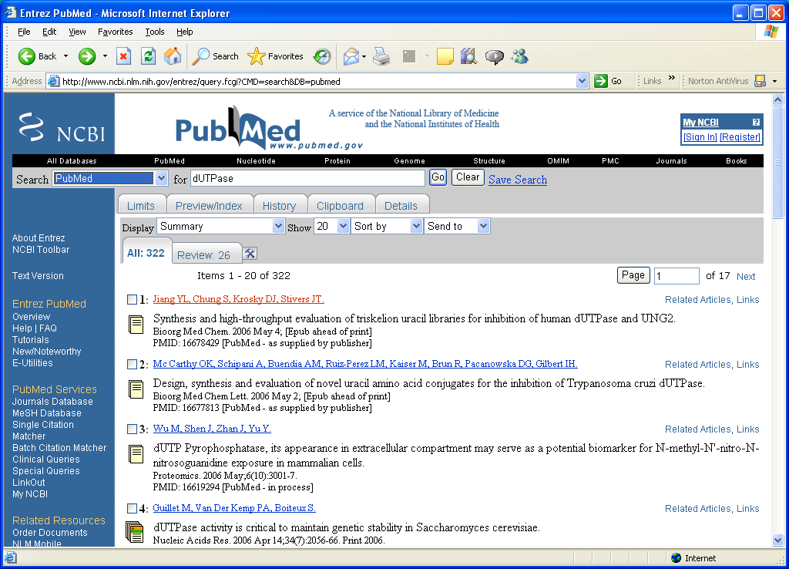
PubMed example
Find out about “dUTPase”

Slide 45
PubMed Example
http://www.ncbi.nlm.nih.gov/entrez/
Find out about “dUTPase”

Slide 46
GenBank
National Institutes of Health (NIH) genetic sequence database
Collection of all known sequences
Each GenBank entry consists of:
  Locus name and accession number
  Reference section – link to relevant articles
  Features
  Sequence

Slide 47
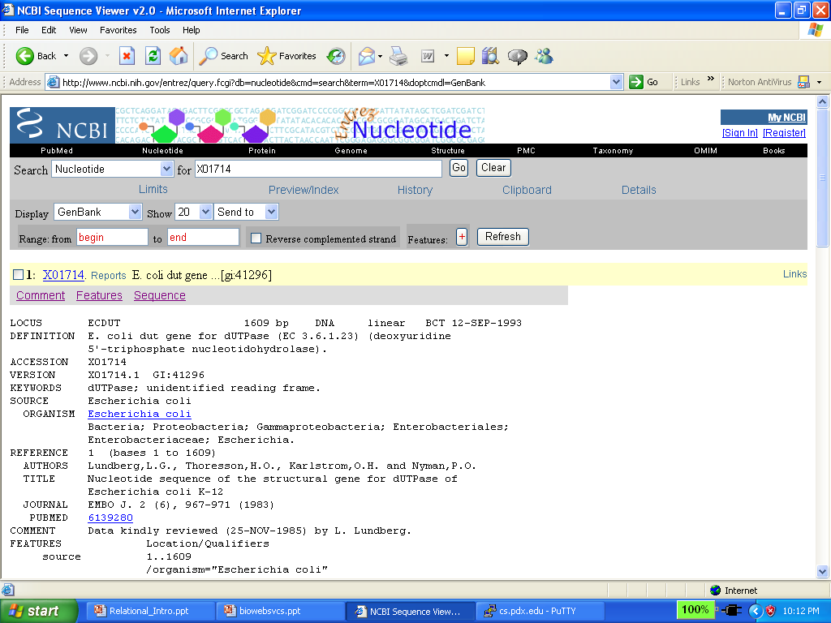

Slide 48
Other scientific domains:
Astronomy:
  http://www.atnf.csiro.au/vo/rvs/thumbnail.html
  Converts astronomy image to thumbnail
Chemistry:
  http://www.liv.ac.uk/Chemistry/Links/webservices.html
GIS
  http://terraservice.net/webservices.aspx

Slide 49
Summary
Web services provide standardized interface to data and functionality on web
  Access to data
  Perform computations
Accessible by machines/programs
Stateless – websites don’t keep track of requests
Preview of things to come: scientific workflows

Slide 50
Other Web Services
Web services exist in many domains
  Stock quotes, conversions, weather…
Web service search engines (e.g., Woogle):
http://haydn.cs.washington.edu:8080/won/wonServlet

